Slide 1
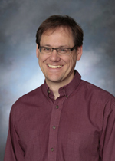
“Dr. DeLyser has been one of the most influential people throughout my college experience. He has been an inspirational teacher, conductor, and advisor and has personally aided me in my goals as a musician and student. I would like to thank Dr. DeLyser for helping shape my musical career and my experience as an undergraduate student.” - Theo
Dr. David Delyser

Slide 2
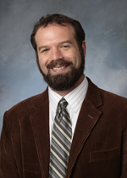
“At the university level, a student hopes their professor will be engaging, welcoming, and excite them about their future. I have found all these qualities in Kevin Jones. 7000 miles away in a different country, and I could still feel the support.” - Anonymous
Professor Kevin Jones

Slide 3
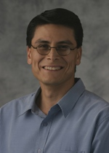
“Alejandro Santana is one of my favorite CAS professors. His passion for Philosophy, life and all things knowable is so genuine that it is contagious. Not only does he inspire others to want to learn more, he also cares greatly for his students. The combination of Dr. Santana's scholastic passion and evident care of his students make him one of my favorite professors at University of Portland.” - Grayson Penfield
Dr. Alejandro Santana

Slide 4
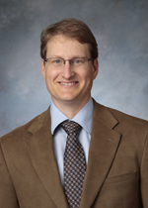
“Dr. Pitzer was the first professor to introduce neuroscience concepts in my classes sophomore year. His class antics and fascinating lectures had a huge impact on my decision to pursue a neuroscience focused career.” - Anonymous
Dr. Mark Pitzer

Slide 5
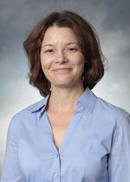
“Dr. Evangelist - You inspired in us a love for philosophy, whether it be issues of ethics or metaphysics. Your passion for teaching and overwhelming kindness is expressed both inside and outside the classroom. Please know that you are loved by your students.”
- Banthony and Lanthony
Dr. Caery Evangelist

Slide 6
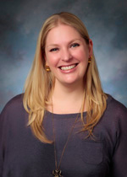
“Nicole Leupp Hanig, you've changed my experience as a vocalist and all-around performer. I'm forever grateful for your teaching! Thank you!”
- Katrina Welborn
Dr. Nicole Leupp Hanig

Slide 7
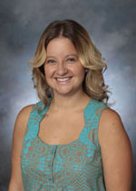
“Vail Fletcher - She always brightens my day and I look forward to going to her class because I know she will put me in a good mood. Her ability to maintain a high energy, entertaining, yet academic environment is astonishing. She is so incredibly down to earth and intelligent, and manages to incorporate her humor into her lectures. She has made learning fun, and has helped me to know that I'm going into the right field of work.” - ML
Dr. Vail Fletcher

Slide 8
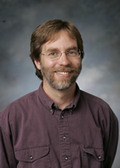
“Dr. Kerssen-Griep has been a huge influence in my time here at UP. The only words I can think of to describe him is that he keeps it real. He is not quick to judge and I have never had a problem expressing any problems or fears to him. I am so glad that he was the professor of my first communication class here, and the professor for one of my last. A great beginning and ending. THANKS KG!” - Ariana
Dr. Jeff Kerssen-Griep

Slide 9
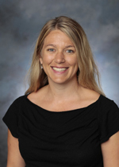
“Professor Lovejoy - There aren't enough words to describe how thankful I am for Dr. Love. Not only was she an incredible professor and teacher, but an amazing mentor. She came to class every day with a fiery passion that lit up the entire classroom, and made class not just interesting, but riveting. Dr. Love is the reason why I love Communications so much, and she gives me drive to continue to pursue my own passions, no matter what they may be. Plus, she keeps you on your toes - from mind-provoking discussion questions to jumping onto tables, class was never a stale place to be.” - Julia Kennedy
Dr. Jennette Lovejoy

Slide 10
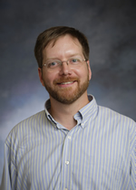
“Dr. Brown has been one of the most influential professors during my time here at UP. His unending dedication to the students is second to none.” - Kevin Klee
Dr. Jeffrey Brown

Slide 11
“Dr. Pitzer has been one of the most influential and motivating professors I have had the pleasure to learn from here at UP. He understands how students naturally learn and uses that to his advantage in his classes making them fun and enjoyable. In fact, he is one of the very few professors whose classes I actually looked forward to attending.” - Anonymous
Dr. Mark Pitzer

Slide 12
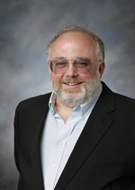
“Dr. Eifler has done much to both fuel my passion for History and redefine how I study it. If it were not for his guidance I would be a very different person.” - Anonymous
Dr. Mark Eifler

Slide 13
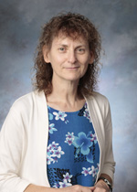
“Dr. Ahern-Rindell - She is so passionate about biology and extremely knowledgable. AR pushes her students to understand material and learn how to investigate their scientific questions. She not only teaches great biology lessons, but also invaluable life-long skills to becoming an excellent biologist.” - Liz
Dr. Amelia Ahern-Rindell

Slide 14
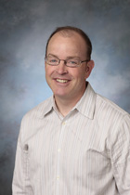
“Dr. McRee has changed my life in more ways than I can possibly count while on campus. From helping me find internships and job opportunities, to allowing me to help with research, and challenging my sociological beliefs and abilities, Dr. McRee is exactly the type of professor that all students dream about but few get to experience.”
- Anonymous
Dr. Nick McRee

Slide 15
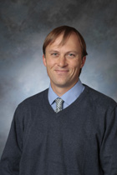
“Dr. Guest's passion for psychology is absolutely inspiring! His dedication to the field is amazing, and he inspires students to care about a broad range of topics within psychology. He has been a great project supervisor for the psychology capstone class. Thank you, Dr. Guest!” - Anonymous
Dr. Andrew Guest

Slide 16
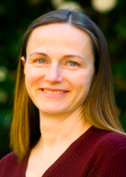
“When I first met Dr. Anissa Rogers, I was surprised at how she spoke with me - as if I had already proved to her that I was a passionate, responsible, and brilliant student. She never treated me otherwise. I've chosen to walk in that identity ever since.” - Anonymous
Dr. Anissa Rogers

Slide 17
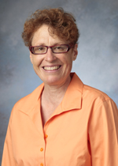
“Dr. Regan helped me recognize that Spanish really is for me. I had a bad experience my first semester here, but her class was just what I needed to feel like I could succeed in the Spanish department here. I am a big believer that the professor’s mentality makes the class. After I took her l Literature in Film class, I changed my Spanish minor to a major.” - Anonymous
Dr. Kathleen Regan

Slide 18
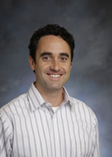
“Dr. Downs - He always made me feel eager to learn and motivated to do well. He's never made me feel bad for asking questions and he is an overall great professor.” - Anonymous
Dr. Andrew Downs

Slide 19
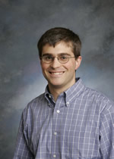
“By maintaining high expectations of his students, Dr. Wood has taught us to have high expectations for ourselves. I didn't know what I was capable of until being pushed to do my best. Thanks Dr. Wood.” - Molly
Dr. Warren Wood

Slide 20
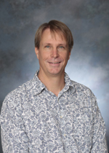
“In one of my first classes at UP, I learned one of the simplest statements that would define the next four years of my life: Question Authority. Not to say I became an anarchist, but Monto taught me to see the world through a different lens. This allowed me to speak up in class and ultimately gain the confidence to understand that no question is a stupid question, only the gateway to further learning.” - Anonymous
Dr. Martin Monto

Slide 21
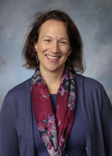
“Professor Rogers, Professor Gates, and Professor Jones of the Social Work department are without a doubt the most caring, compassionate, and knowledgeable educators on campus. Their dedication to their work and their students inspires and challenges me daily to look beyond myself to strive and serve others through any means that I can. Thank you for teaching me to question the paradigms of society, to look holistically at individuals and communities, and for igniting within me the desire to become a radical social worker ‘The Man’ will fear.”
- Anonymous
Dr. Anissa Rogers
Dr. Alice Gates
Professor Kevin Jones

Slide 22
“Dr. Eifler of the history department was probably my favorite professor. I took a few history courses from him, and every day I looked forward to his classes. His humorous, yet critical view of history was infectious, and I learned so much from him.” - Kathryn Walters
Dr. Mark Eifler

Slide 23
“Dr. Pitzer - He brings an amazing energy to the classroom that made me want to learn more of the material. The classes are never boring because of how excited he is to teach us new material. His energy made me want to learn, which is a special gift for a professor.” - Anonymous
Dr. Mark Pitzer

Slide 24
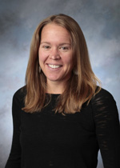
“I didn't meet Dr. Maginnis until I was a senior at UP, however, in the short time I have known her she has had the greatest impact on me of anyone I have met from UP. Dr. Maginnis is a wonderful professor--engaging, honest, and respected. She loves what she does and is great at relating to students and encouraging us to actually apply/consider what we learn. I encourage all students to take at least one class from her. I promise you will learn so much and have fun at the same time.” - Anonymous
Dr. Tara Maginnis

Slide 25
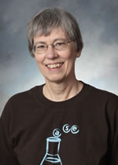
“Dr. Hoffman is one of the nicest and most understanding professors I have ever met. She shows great passion for her work, her students, and the science behind it all. Her enthusiasm and outlook regarding biochemistry is infectious and has given me a greater appreciation towards science and health care.” - Benjamin Co
Dr. Angela Hoffman

Slide 26
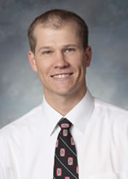
“Dr. Kyle Flann - His ability to meld the textbook material and its relevance to outside experience was highly valuable to my motivation in pursuing research and experience. I believe that because of what I learned from him in Physiology, I was able to push myself to get all of this experience at different institutions with regard to research, as well as perfect my studying habits in college.” - Anonymous
Dr. Kyle Flann

Slide 27
“Dr. Brown has been one of my favorite teachers from day one at UP. From the intro bio days my freshman year all the way to writing my letter of rec as a senior, Dr. Brown has helped me both as a student and as a person, and I'm so blessed to have a professor that cares so much about who I am and where I want to be.” - Anonymous
Dr. Jeffrey Brown

Slide 28
“Dr. Pitzer's Sensation and Perception class sophomore year was an absolute turning point for the way I learned and how I questioned. What began as extreme intimidation for the world of neuroscience has since become the reason why I became a psychology major. I can't express enough how thankful I am for Dr. Pitzer's captivating teaching and ability to enrich student curiosity and excitement about the field, and to that I say ‘alright, alright, alright.’ ”
- Emma Burick
Dr. Mark Pitzer

Slide 29
“Dr.Tara Maginnis - Her passion for Marine Biology is evident and contagious.” - Anonymous
Dr. Tara Maginnis

Slide 30
“Dr. Amelia Ahern-Rindell has helped me see the value of research in the context of undergraduate education and my plans for the future. That being said, Dr. Brown and Dr. Wood have been wonderfully helpful throughout my undergraduate career here at UP!” - Anonymous
Dr. Amelia Ahern-Rindell
Dr. Jeffrey Brown
Dr. Warren Wood

Slide 31
“Dr. Mark Pitzer - Working with him was always an adventure and his classes were so lively. He inspired me to get a neuroscience minor, and I hope that someday I can have students who love me half as much as students love Mark.” - Sydney
Dr. Mark Pitzer

Slide 32
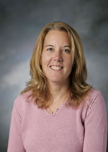
“I am so grateful that I was able to have Dr. Shannon Mayer as a professor. I always felt comfortable and welcome in her office for school related and non-school related help. She truly cares for the students at UP.” - Anonymous
Dr. Shannon Mayer

Slide 33
“Dr. Wood! I couldn't have imagined getting through Organic Chemistry without Dr. Wood! Not only was he passionate about the subject, but he was passionate about helping his students succeed! You could tell that he truly cared for his students’ education!”
- Anonymous
Dr. Warren Wood

Slide 34
“I can attribute the bulk of my success at UP to Dr. Tara Maginnis, and her remarkable guidance and support. Her passion for evolutionary biology is contagious, and has been irreversibly enveloped into my future career goals… UP can simply not afford to lose professors, like Tara and others, that care for students and provide them these opportunities to learn and thrive…”
- Tai White-Toney
Dr. Tara Maginnis

Slide 35
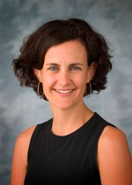
“Dr. Hiro taught me not to find answers, but to find questions, to grapple with conflicts in texts rather than cleanly resolve them, to understand how something as small as a semicolon can transform an argument, how the most worthwhile things are those that are strange, confusing, or surprising, that writing can be both messy and joyful, and to never undervalue walking through library book stacks.” - Katie Stringer
Dr. Molly Hiro

Slide 36
“Professor Santana's logic class taught me that even though I am bad at math, I can still be good at logic. He taught that class so well that I will never forget how awesome modus tollens is.” - Tom Bluth
Dr. Alejandro Santana

Slide 37
“Professor Kevin Jones has seen me at my worst as a student. However, he always challenged me to do and be better. This final year I have worked harder than any other year and I am proud of what I have done.Thank you, Professor.” - Neidin Poole
Professor Kevin Jones

Slide 38
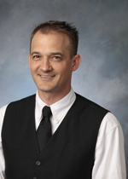
“One of my favorite professors in CAS is Dr. Lars Larson. He is the reason that I did not give up on my dream to apply for Graduate School and helped me realize my love of teaching and being a support for other students. Thanks Dr. Larson!” - Leah Becker
Dr. Lars Larson

Slide 39
“Dr. Pitzer is at once instantly relatable, knowledgeable, and an excellent communicator of ideas. And he can diagram the rhodopsin-G protein relationship like nobody's business.” - Anonymous
Dr. Mark Pitzer

Slide 40
“Dr. Vail Fletcher - Not only did she make learning an enjoyable experience. But Fletch constantly asked the class to question ideals that they believed to be innate. While sometimes this was difficult and uncomfortable to say the least, the experience is one I will never forget. I am so grateful to have had the privilege of learning from such an incredible human being.” - Anonymous
Dr. Vail Fletcher

Slide 41
“Dr. Hiro drives her students with her energy and focus to keep pushing themselves beyond what they think is within their capabilities. While she teaches it as a writing skill, for the past four years this perseverance has seeped into my daily life. When I'm tired and feel satisfied, I think of Dr. Hiro. She makes me keep going so I can feel proud and inspired.” - Anonymous
Dr. Molly Hiro

Slide 42
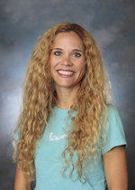
“The psychology department is full of excellent professors. Dr. Julka, however, stood out from the group during my college career at the University of Portland. As my advisor, she has provided me with the support I needed to succeed academically as well as in ways that go beyond the classroom. She recognized my potential and pushed me past my comfort zone so that I could achieve more than I ever thought I could. Thanks to Dr. Julka, I am pursuing graduate school and I know I have the skills to succeed. Even more memorable than Dr. Julka's kindness is probably her upbeat personality. Classes were always enjoyable because of this.” - Melissa Bondra
Dr. Deana Julka

Slide 43
“Dr. Els - Even though I heard all of his jokes multiple times, he never failed to entertain me in class. Additionally, Dr. Els instilled in me a love of history that grew tremendously during my time here at UP. Stay cynical, sir.” - Corinn Evancho
Dr. Brian Els

Slide 44
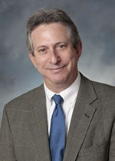
“Dr. Herman Asarnow - This is a professor who will go out of his way to meet with you outside of class to talk about your papers or just to chat, to grab coffee or lunch with a student, to stay in contact with them over the years, even to help with their goals outside of college. He has a great passion for his subject and he truly connects with students. He'll be greatly missed at UP!” - Anonymous
Dr. Herman Asarnow

Slide 45
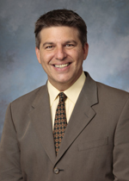
“Dr. Andrews - The only class I have ever taken with this man was Philosophy of Religion my sophomore year. When I entered that classroom, I was continually challenged to think deeper, find stronger evidence, and support my arguments clearer. Since then, I have continued to strive to live up to the expectations this man has had for me. His dedication to helping me through my capstone project has been inexplicably valuable to my learning. I value all of the rewrites, red ink, or confused looks that Dr. Andrews and I shared because they make me understand the importance of true intellectual growth and personal development.” - Anthony Bedoy
Dr. Michael Andrews

Slide 46
“Dr. Mark Pitzer - I have liked all of my professors but Pitzer stands out. I loved his classes, and I love the way he teaches. He has a certain charisma that made it so I never wanted to miss a class. Even when I was completely unmotivated and feeling down his classes could always make me smile and remind me of why I wanted to come to college in the first place. Thank you Mark.”
- Kessa Douse
Dr. Mark Pitzer

Slide 47
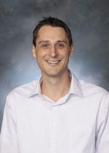
“Professor Franco - He pushes you to produce your best work. Without that emphasis on hard, quality work, I doubt that my successes so far, and my ability to practice and write history, would be anywhere near the level it is at now. Not only that, but he makes history interesting and fun by showing the crazy amount of connections littered throughout it, and how things that seem like nonsense actually fit perfectly in their historical context. I thank him for my understanding and excitement of history.” - Anonymous
Dr. Bradley Franco

Slide 48
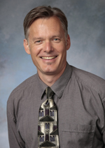
“Larry Larsen has done so much for me at UP. He's given me great opportunities, helped me through rough patches, and taught me an incredible amount.” - Clarke Orr
Dr. Lawrence Larsen

Slide 49
“Dr Brown - He is always smiling and is genuinely interested in getting to know his students and interested in their future. He is an amazing professor that is able to keep his students engaged and is an overall warm spirit. He will take time out of his busy day just to say hi and quickly catch up. He definitely brightens my day when I see him.” - Anonymous
Dr. Jeffrey Brown

Slide 50
“Dr. Alice Gates forced myself and other students to broaden our understanding of social work to include revolutionary ideas of change in an engaging and fun style. Her classroom discussions have caused me to think more critically about oppression and discrimination than any other social work course I have taken at UP.” - Anonymous
Dr. Alice Gates

Slide 51
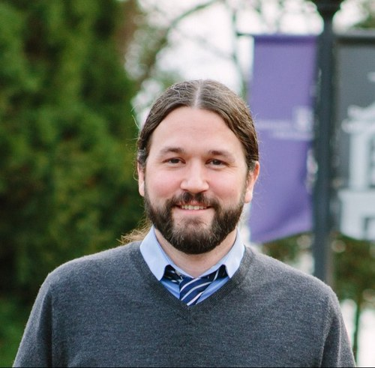
“I don’t think I would have such a love for Sociology and Criminology if I had never had Dr. Bryan Rookey as a professor and mentor. The care he has for his students and the interest he takes in our work has inspired me greatly. There wasn’t one class I had with him in which he didn’t challenge us to think beyond the boundaries of traditional learning. Thank you Dr. Rookey!” - Alana Inlow
Dr. Bryan Rookey

Slide 52
“Dr. Fletcher will go down in history as the only professor who has or will ever refer to me as "dawg" (something I find to be strangely flattering). Her wonderful sense of humor and down-to-earth nature have made for some of my favorite learning experiences at UP. She has come to be not only a great mentor, but also a friend to me - one that I hope to keep in contact with after I leave college.” - Jillian Stephens
Dr. Vail Fletcher

Slide 53
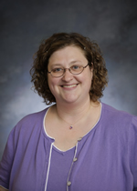
“Dr. Amy Beadles-Bohling - Thank you for taking a chance on us, teaching us, and introducing us to the world of Neuroscience research! We couldn't have asked for a better mentor and fantastic summer. Your devotion to research and students is inspiring, we will miss you!”
- Dayna, Kylie, and Megan
Dr. Amy Beadles-Bohling

Slide 54
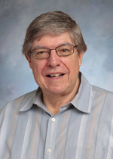
“Dr. Bob Duff was one of the first professors I talked to when I started at UP. He instilled in me the self-confidence and open mindedness that I needed to make my learning experience here better than anything I could have imagined.” - Anonymous
Dr. Robert Duff

Slide 55
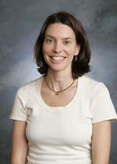
“I've constantly been validated and encouraged by Dr. Hancock's personal perspective on History; understanding the role of the female experience in the past is not only important and necessary for the field, but it has helped me in shaping my own experience.” - Anonymous
Dr. Christin Hancock

Slide 56
“Dr. Jeff Kerssen-Griep has impacted my experience at UP as he has taught me to think differently about the world. He has shown me new ways to view others and even better, myself, in the process. He also helped me solidify my desire to go into organizational communication as he was one of the first communication professors I had experience with at UP.” - Anonymous
Dr. Jeff Kerssen-Griep

Slide 57
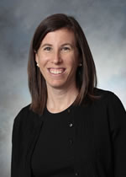
“Dr. Cara Hersh - She taught me to love Chaucer and Medieval Literature. She also taught me how to really explore all the ins and outs of literature and made me excited to teach my own students someday!” - Ailis Thornhill
Dr. Cara Hersh

Slide 58
“Dr. Anissa Rogers has made a big impact on my involvement in Social Work. When I first was trying to decide which major to switch to from Biochemistry I was sent to her office to ask questions. I told her my interests and instantaneously she encouraged me to sign up for her Human Behavior class. Her teaching style and passion for social work was contagious and I fell in love with social work.” - Amanda Ewing
Dr. Anissa Rogers

Slide 59
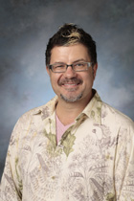
“Professor Gregory Pulver has been an amazing teacher and has inspired me to reach for my full potential. He has given me so many amazing opportunities and I feel like I can go so far with everything that he has taught me both in and outside the classroom.” - Kristen Gates
Professor Gregory Pulver

Slide 60
“Dr. Pitzer has by far been my favorite and most influential teacher, not only at UP but in all of my previous academic settings. I really can't say enough about him. I've never walked out of one of his classes bored, and I have always tried to take as many classes with him as I could. He's not the reason I became a Psychology major, but he's definitely one of the reasons I've remained one. Cheers to you Mark.” - Christian Scarcella
Dr. Mark Pitzer

Slide 61
“Dr. Andrew Downs brings his passion for psychology to every class he teaches. He is committed to helping his students, goes out of his way to offer support, and actually incorporates student feedback into his classes. Dr. Downs’ support and enthusiasm have helped me develop my research interests and my own excitement for psychology.” - Anonymous
Dr. Andrew Downs

Slide 62
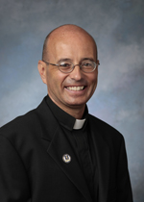
“Father Cooper - This man has provided experiential and intellectual insight into the hearts, minds, and lives of so many on this campus, including myself. His courses on spirituality coerced me to dive into my own spirituality and how it influenced the rest of my life. Hardly will I be able to live my life without remembering that my spirituality must inherently be connected to my lived experience everyday thanks to this man.” - Anthony Bedoy
Rev. Jeffrey A. Cooper, C.S.C.

Slide 63
“Dr. Vail Fletcher - She has played a huge role in my development not just as a student but as a human being. I'm going to miss her passionate teaching methods and her willingness to let the students express themselves individually through their work. You're the best Vail, Much Love”
- Colin Feldtman
Dr. Vail Fletcher

Slide 64
“Dr. Ami Ahern-Rindell - It is so motivating and inspiring to see a faculty member take so much interest in the growth of her students. She is so helpful and intelligent and her dedication to advancing the way in which science is taught is truly remarkable. She has been so influential in my growth as a student and as a person, I am forever indebted to her.” - Kylie Leffler
Dr. Amelia Ahern-Rindell

Slide 65
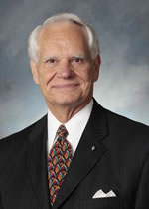
“Dr. Faller, you have been a professor outside of my two majors who has really stood out to me as someone I will remember for a long time. I enjoyed the countless jokes you made in class, hearing stories about your life, and talking with you after Bioethics about weddings and you and your wife. Your broad impact and experiences throughout the world is astounding and I am so honored to know you! Thank you for being a wonderful professor and for sharing your life with students. Just don't let the compliments go to your head too much…” - Ashley Woster
Dr. Thompson M. Faller

Slide 66
“Dr. Gates has changed the way I see the world. She has helped me take a huge passion for humanity and turn it into something powerful and useful. Dr. Gates is challenging, encouraging, and intelligent. I can't imagine UP without her.” - Anonymous
Dr. Alice Gates

Slide 67
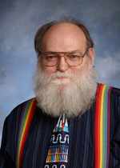
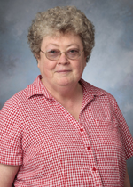
“Dr. Raymond Bard and Dr. Ronda Bard have both been inspirational as teachers, especially in the Chemistry laboratories. They both have an obvious dedication to student learning and work tirelessly to help students in any way that they can.”
- Anonymous
Dr. Raymond Bard
Dr. Ronda Bard

Slide 68
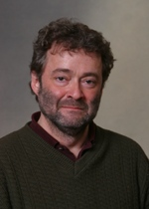
“Dr. Askay has made me realize how applicable philosophy can be to my daily life. He makes philosophy relevant!” - Anonymous
Dr. Richard Askay

Slide 69
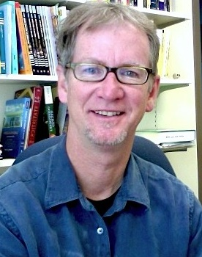
“Dr. Hill has been a wonderful teacher and mentor throughout my four years at UP. I appreciate the encouragement and guidance I have received academically and otherwise. Danke!” - Rebecca Larrabee
Dr. Gregory Hill

Slide 70
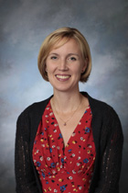
“Dr. Van Hoomissen - Thank you for the many hours you have devoted to teaching us and helping shape our diverse interests. We are amazed at the amount of research you balance as well as your never ending commitment to students. Thank you for a wonderful spring semester and introducing us to Public Health!”
- Megan, Dayna, and Kylie
Dr. Jacqueline Van Hoomissen

Slide 71
“Dr. Pitzer is without a doubt my favorite professor at UP. His passion for teaching and interacting with students are what make his classes so enjoyable. He is just a great professor to have here at UP.” - Hunter Lee
Dr. Mark Pitzer

Slide 72
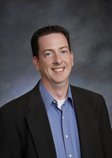
“Dr. Patrick Murphy - Thank you for an incredible last two years and for enriching my life as a student and musician. Some of my most cherished memories at UP are conducting the Wind Symphony, thank you for inviting me to be a conducting associate and your constant encouragement. Looking forward to future conversations of "macropatterns" and coordinate movement for conductors!”
- Kylie Pybus
Dr. Patrick Murphy

